Slide 1
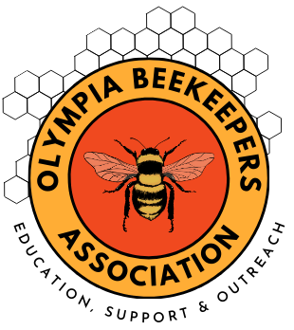
Nosema
Olympia Beekeepers Association
February 10, 2025
Brian Fackler
Cornell University Master Beekeeper
Washington State Master Beekeeper

Slide 2
Fungus is essential for honey bee digestion and bee bread but not all fungus is beneficial, such as the brood disease Stonebrood and Chalkbrood, as well as todays topic Nosema
WSU and Fungi Perfecti have created a mushroom fungus extract, which when fed to honeybees reduces hive virus levels
If you notice spotting or fecal dropping on your hive front – next you check the internet and suspect dysentery and you decide the cause is Nosema. You go to your bee supply catalogue or internet site “Mann Lake” and there is a full-page ad for the only authorized treatment Fumagillin (Fumidil-B)
Did you make a correct diagnosis and decision for the health of your bees?

Slide 3
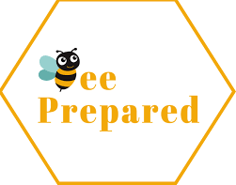
Agenda
What Is Nosema
Life Cycle
Prevention and Management
Symptoms of Colony Infection
Nosema Apis and Ceranae
Infected Queens Drones and Workers
Where to Send Samples
You Can Diagnose The Disease
Fumagillin
Natural Products
Nosema and Pesticides
Beekeeper Options and Actions
Nutrition Management
Varroa IPM

Slide 4
Nosema Disease
Affects Mostly Older Adult Honey Bees and May not be Present in all Colony Bees
The Spores in the Midgut limit the Ability to Absorb Nutrients
Nosemosis (nos a mao sus) Is a Serious and Widespread Bee Diseases
Is Present in 50%+ of all Colonies and Can Collapse a Weakened Hive
Caused by Environmentally Resistant Fungal Spores and Spread By Bees
Nosema Apis and Ceranae are both a single cell Microsporidian Fungus
Nosema Apis Described in 1909 by Enoch Zander
Nosema Spores Spread by Bees discovered in 1919 by G.F. White
Nosema Ceranae present in Asia in 1996
In 2020 the Species Reclassified to Genus Vairimorpha and not Nosema

Slide 5
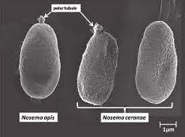
Life Cycle
Adult honey bees ingest spores In contaminated food and or fecal matter
In the host bee’s midgut the spores grow and multiply in what is called the Vegetative Stage to 30-50 million spores and in 6–10 days. Spores are excreted with the feces and the cycle is repeated.
Spores Spread by Bees:
Ingesting Fecal matter
Trophallaxis (trof-uh-lak-sis)
Nest Grooming
Cleaning Cells
Drone Sperm
Foraging on flowers

Slide 6
Prevention and Management
At five years maximum replace frames or remove comb from plastic frames
Reduce exposure to pesticides, fungicides and herbicides
Keep colonies healthy and strong
Good hive location and drainage
Sun exposure especially in winter
Hive moisture ventilation in the nectar season
Winter moisture hive condensing or ventilation
Build up weak hives – syrup, pollen & frames of brood w/nurse bees
Replace queen mated by drones genetically diverse especially older queens
Caution in swapping frames among hives and combining hives
Prevent Robbing
Use known local queen sources as Canadas found bees imported from New Zealand have low resistance to Nosema

Slide 7
Symptoms of Colony Infection
Reduced honey production
Dwindling population
Queen supersedure
Winter Colony Loss
Often present In weak colony in spring
Slow to produce brood and honey
Microscopic examination or molecular analysis needed for positive diagnosis
Primary location bee mid-gut which often found swollen and whitish appearance
Symptoms often confused with other conditions the affecting adult honey bees
Fecal material on comb and hive entrance
Life span reduced 20-50%
Dysentery often resulting from fermented honey, dark honey with high ash content, unripen honey/syrup with high moisture content or when confined to the hive for extended periods – avoid leaving uncapped honey or sugar syrup over winter confinement

Slide 8
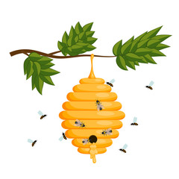
Nosema Apis
Crawling Behavior
Swollen Abdomens
Inhibits Digestion
Dysentery recently disputed
1% or less of all infections in USA
Excessive Winter Excrement w/Spotting on Hive Exterior
Fumagillin Can Be Effective
Winter High Spore Count
Less Than 100 Spores Can Cause Infection
Associated with Long Winters and limited Flight Opportunities
Nosema Ceranae
Produces more spores in the bee’s guts
Nearly 100% of all Nosema infections in USA
Can infect Bumble Bees
No Spotting on Hive Exterior
Fumagillin may Exasperate the Infection
Spore Counts can increase and Decrease in Warmer Weather
Associated With Warmer Climates
Honey Bee Immune System Reduced
Nosema Neumannis
Recently discovered in Ugandan Honey Bees
Distribution and morbidity not determined

Slide 9
Infected Queens Drones and Workers
Worker Adult Infected Bees – consume more food – reduced fat bodies – smaller Hypopharyngeal (hy po pharynx geal) glands effecting brood food – produce less royal jelly – forage earlier in life and less efficient – die nine days sooner than non infected bees
Queen Infected Bees – have shortened life span – often cease laying eggs and die after a few weeks
Drone Infected Bees – loose sperm viability faster than normal – have a shorter life – transmit infection more easily then workers – thus drones are super spreaders

Slide 10
If infected
Freeze hive woodenware, frames and comb 4 Days
Fumigate w/Acetic Acid
Expose to Heat 120F 24 hours or 140F 15 minutes
Expose to gamma radiation
Consider Fumagillin application
Hive bodies, bottom boards, inner covers or any other wooden parts of the hive can be fumigated with various chemicals but none are very practical for the hobby beekeeper—or they can be scorched with a blowtorch - disinfect is with heat - The susceptibility of Nosema ceranae spores to freezing may help to explain why it appears to be more of a problem in warm areas.

Slide 11
Where to Send Samples For Analysis
Oregon State University
Honey Bee Lab
OSU Horticulture
2750 SW Campus Way; ALS 4017
Corvallis, OR 97331
Washington State University
WSU/Entomology
Reams / 166 FSHN
100 Dairy Road
Pullman, WA 99163
USDA Bee Research Laboratory
Bee Disease Diagnosis
Bee Research Laboratory
10300 Baltimore Ave. BARC-East
Bldg. 306 Room 316
Beltsville Agricultural Research Center - East
Beltsville, MD 20705
Notes:
Oregon State University
Send 300 bees from a brood frame. They should be collected live, but then frozen to kill them. Send in a sealed plastic container or Ziplock bag...they don't need to be sent with ice or dry ice. No charge!
Washington State University
The sample can contain a minimum of 100 adult bees (~1/4 cup) taken from a brood frame and can be shipped in a leakproof container full of rubbing alcohol or windshield washer fluid. We are planning to expand the diagnostic lab in the near future, but at the moment our diagnostic lab can only handle a small number of samples which we would process free of charge. A donation to the bee program would be greatly appreciated
www.foundation.wsu.edu
USDA Bee Research Laboratory
Send at least 100 bees and if possible, select bees that are dying or that died recently.
Bees should be placed in and soaked with 70% ethyl, methyl, or isopropyl alcohol as
soon as possible after collection and packed in leak-proof containers.
USPS, UPS, and FedEx do no accept shipments containing alcohol. Just prior to
mailing samples, pour off all excess alcohol to meet shipping requirements.
Do NOT send bees dry (without alcohol).

Slide 12
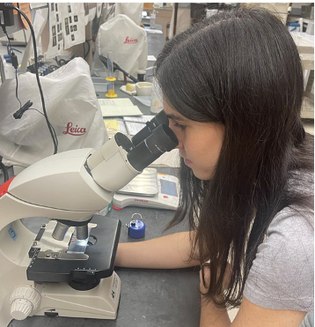
You Can Diagnose The Disease
The only way to diagnose the diseases are through compound microscope examination with 400 times magnification
Collect 50 adult bees from the entire colony and euthanize
Separate the abdomens with small scissors
Place in a small plastic bag and crush and a jar works well
Add 50 milliliters of water (one milliliter water per bee abdomen)
Use an eye dropper to pick up the solution hemocytometer slide with cover
Place the slide on the microscope and count the spores in each grid
Hemocytometer (hee·muh·sai·taa·muh·tr) contains two grids each contains 25 large squares consisting of 16 smaller squares.
Average the spores counted in the left and right chamber and multiply by 50,000, which will provide the number of spores per bee.
The average spring infection rate is 0.87 million spores per bee
The average fall infection rate is 0.23 million spores per bee
Treatment level – 1 million spores per bee per Bee Informed Partnership
WSU seminar on department website and on YouTube for Nosema diagnosis: https://youtu.be/aCBO_cP5GiY?si=LLO_3F7131RVDL84 https://bees.wsu.edu/diagnostics/

Slide 13
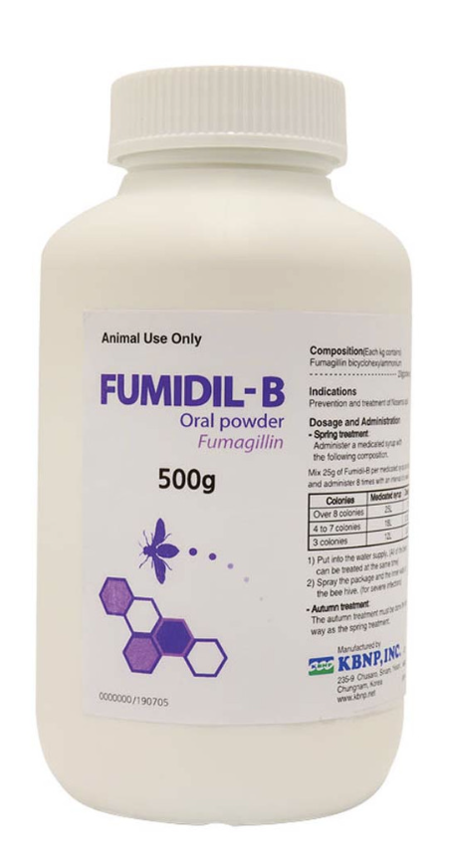
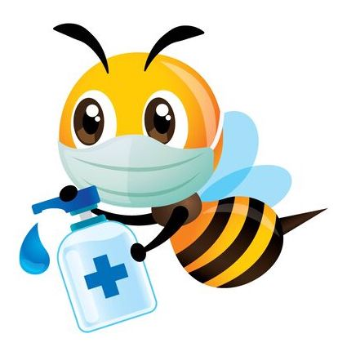
Fumagillin – Is It Effective? – Is it Safe For Bees And Humans ?
Fumagillin is an antibiotic derived from a fungus originally to control Nosema Apis since the 1950’s – this inhibits an enzyme in the Nosema parasite and not the spores – hives with Nosema Apis when treated in the fall significantly increases survival in the spring.
For Nosema Ceranae studies find the spore production 100% higher 20 days after treatment – indicating increase in infection
Use of Fumagillin targets an enzyme MetAP2 needed in the midgut - do not treat prophylactically as it does have negative consequences to the bee’s health
Fumagillin is toxic to humans and residues present in honey can pose a risk to human health including cramping, diarrhea and weight loss.
Fumagillin-B also contains (DHC) with potential human chromosome damage.
Fumagillin feed in the spring and early summer indicates improved colony growth as well as honey production.

Slide 14
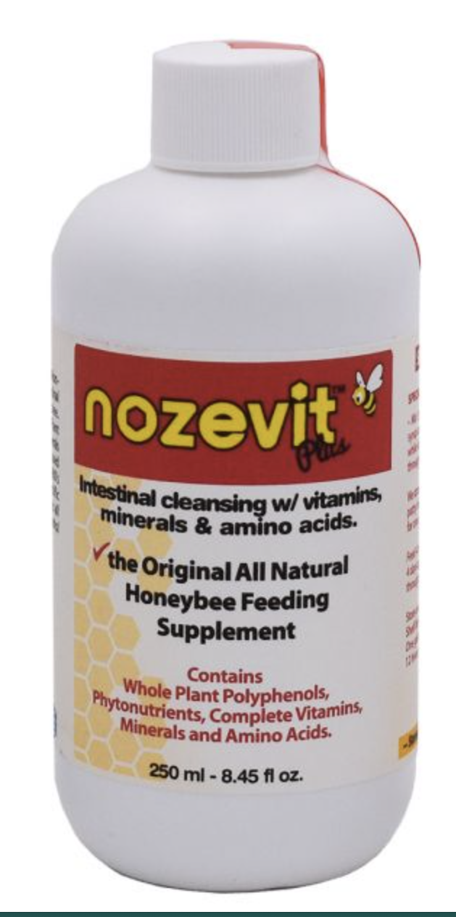
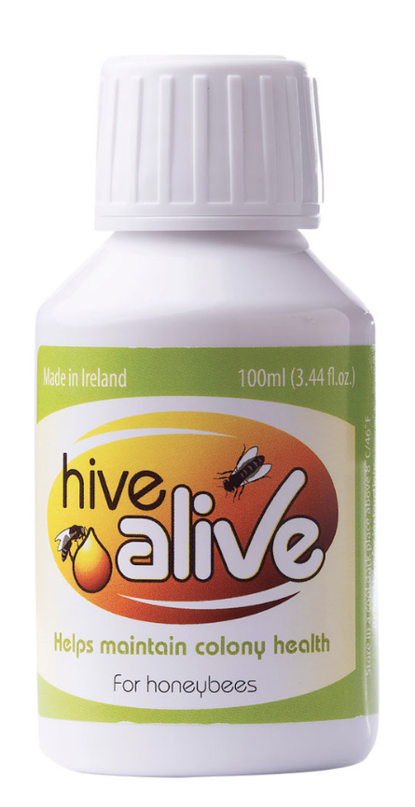
Natural Products – Do They Work –Maybe?
Nosevit – made from oak bark extract – common use in Europe – no scientific evidence – not registered in USA as a treatment – beekeepers are permitted to use.
HiveAlive – made from seaweed extracts, thymol oil and lemongrass oil – fed to colonies mixed with sugar syrup – one study found efficiency against Nosema Ceranae with colonies fed autumn in syrup, in winder candy board found
spores reduces 50% - not registered in USA as a treatment – beekeepers permitted to use.
Honey-B-Healthy – used as a feeding supplement added to sugar syrup comprised of lemongrass, spearmint and essential oils – improves overall colony health – can cause robbing during low nectar times or dearth especially in the fall.

Slide 15
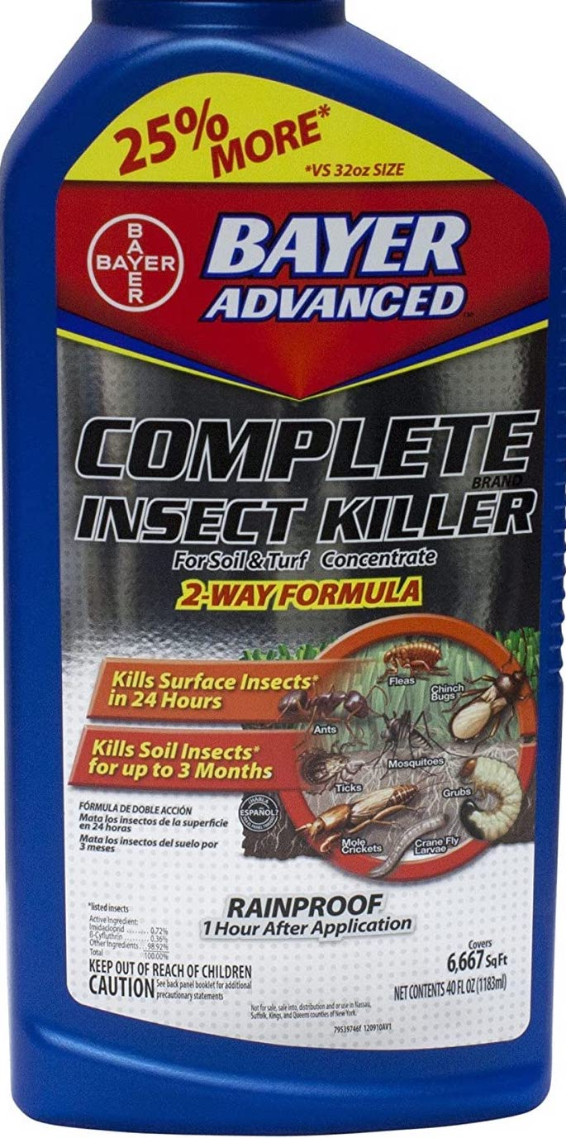
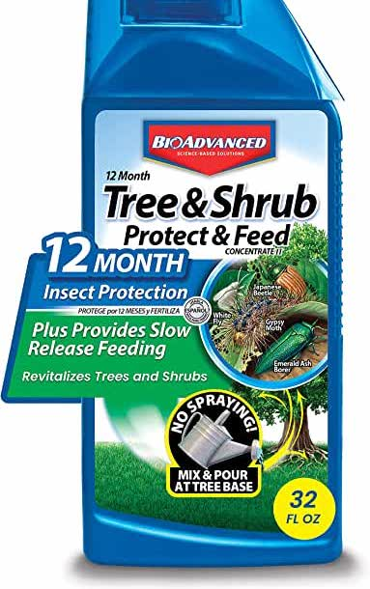
Nosema and Pesticides
Stress factors interaction studies are only beginning to understand the interactions.
Exposure to some of the neonicotinoid (NEE oh nik ti noydz) insecticides increases the bees susceptibility to Nosema infection, with a increased death rate the exposed bees indicating the two stress factors interact synergistically.
Bees from brood comb with residue from pesticides are more likely to develop Nosema ceranae infections as adults – thus the environment in which bees develop is a factor in infection susceptibility

Slide 16
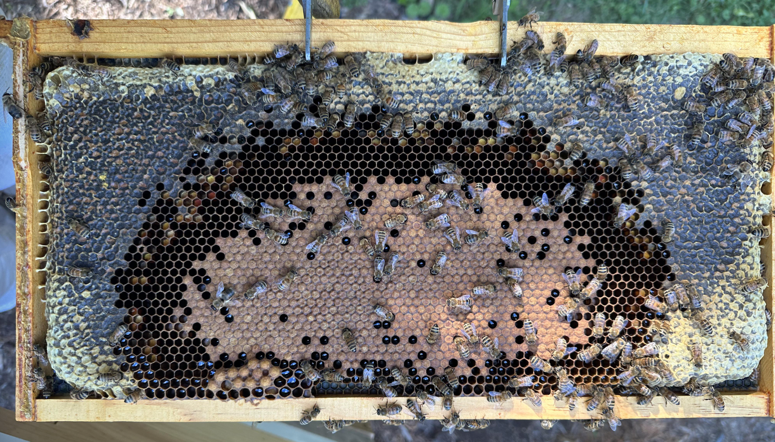
With Limited Effective Control Options
Brood Frame Varroa and Nutrition Inspection is Essential
Honey (Carbohydrate )
Pollen (Protein) of varied sources with differing colors
Varroa monitoring and treatment

Slide 17
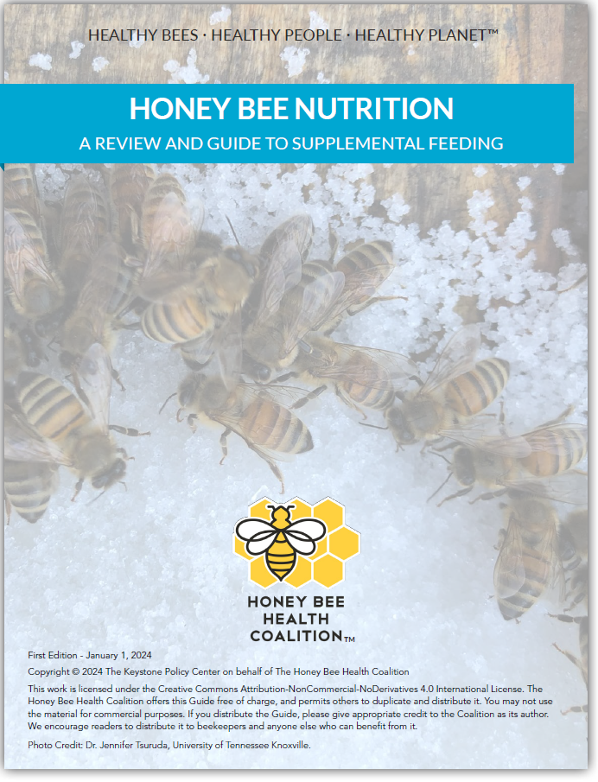
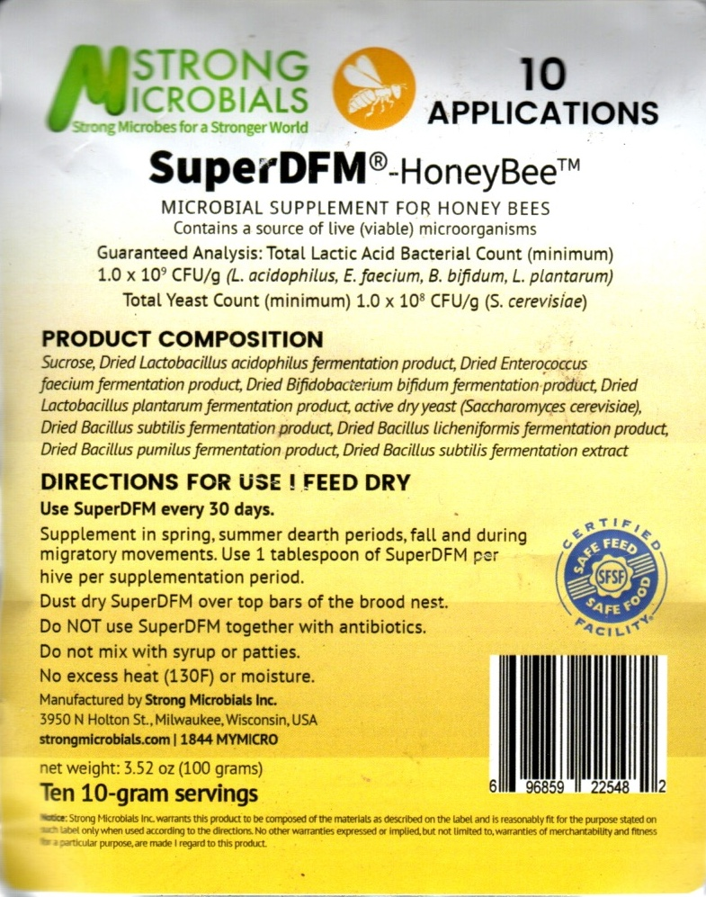
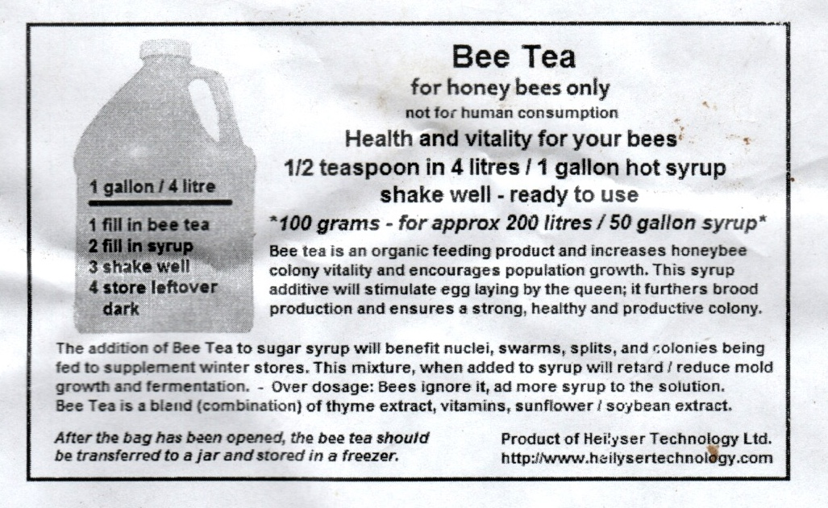
Nutrition Management
100% White Granulated Sugar
Candy Boards
Fondant
Sugar Cakes
Pollen collected from your healthy hives
Pollen Patties
Super DFM Probiotic
Bee Tea

Slide 18
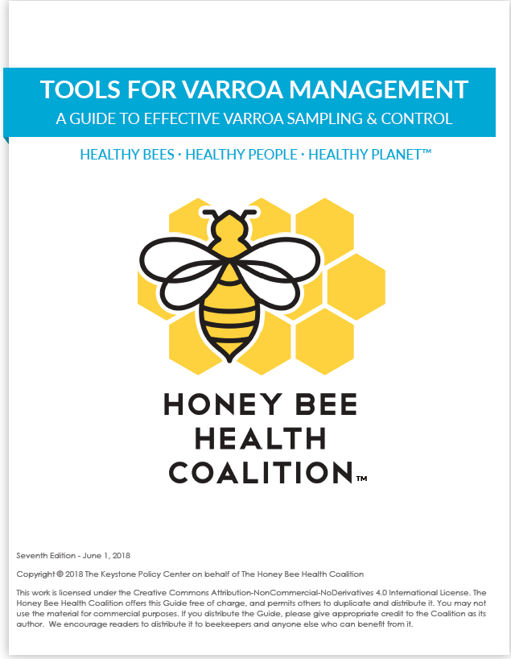
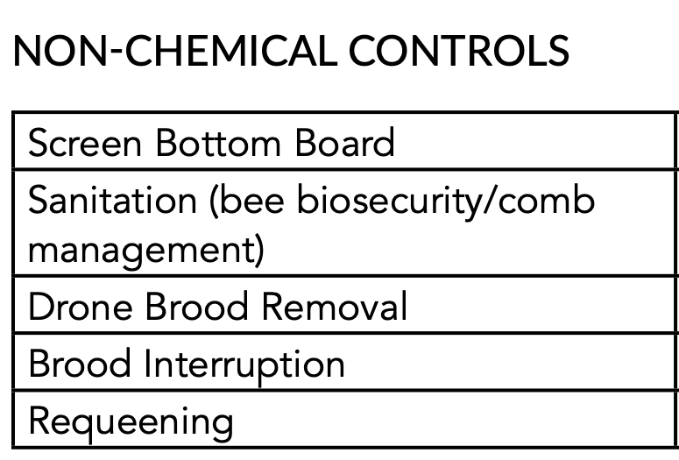
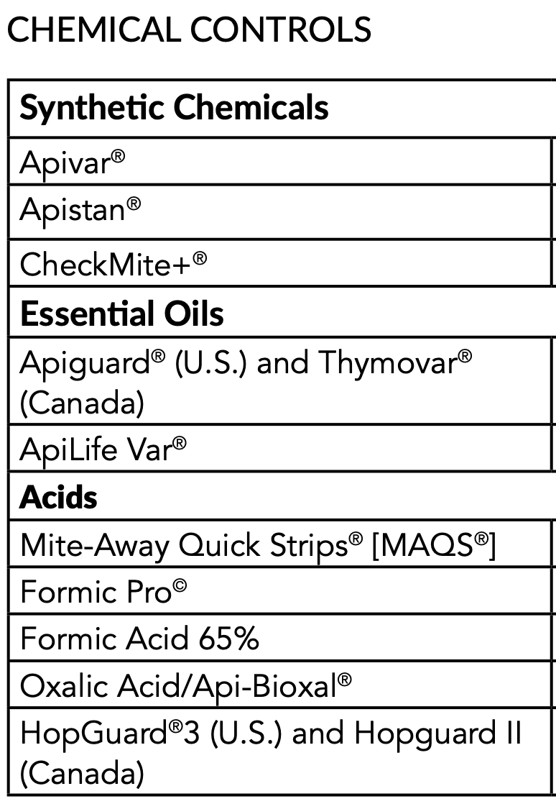
Varroa IPM

Slide 19
Key Points to Take Home
Nosema is a Serious and Widespread Disease
Your bees have a 50%+ chance of being infected
Your beekeeping practices are your best defense
Most Commercial Products are not Effective
WSU and OSU your best options for analysis
Proactive assessment and management for Varroa and nutrition is critical for health of the colony
If you have a serious Nosema infection there is no good solution

Slide 20
References
Evaluating the Efficacy of Common Treatments Used for Vairimorpha (Nosema) spp. Control – Cody Prouty, Cameron Jack, Ramesh Sagili and James Ellis – 2023
Do diet and Fumagillin treatment impact Vairimorpha (Nosema) spp. infections in honey bees and improve survival and growth of colonies overwintered in cold storage? - Gloria DeGrandi-Hoffman, Vanessa Corby-Harris, Henry Graham, Mona Chambers, Emily Watkins deJong, Lucy Snyder, , Journal of Economic Entomology, 2024
The Hive and the Honey Bee,, revised 2015, Disease and Pest of Honey Bees by J.S. Pettis, Y.P. Chen, J. Ellis, J. D. Evans, K.D. Rennich, D. Vanengelsdorp & H. Shimanuki – pages 841-844
Honey Bee Biology and Beekeeping, third edition 2022 by D.W. Caron and L.J. Connor – pages 413-415
Honey Bee Disease & Pests, Canadian Association of Professional Apiculturists by D. Ostermann & G. Williams – pages 16-19
What Do You Know everything you’ve ever wanted to know about honey bees, beekeeping and the world they inhabit, 2003 by C. H. Collison – pages 202-278
Cornell University Master Beekeeping Part III Managing Pests and Diseases – Module 3: Nosema
Eastern Apicultural Society (EAS) – Master Beekeeper Written Exam 2017 and 2018
Intestinally Indisposed: Nosema Infection in Honey Bees – Holly Holt PhD – Penn State Department of Entomology
Diagnosis and Treatment of Common Honey Bee Diseases – Ben Sallmann and Rob Snyder 2014 – Bee Informed Partnership
Honey Bee Health Coalition – Tools for Varroa Management – Best Management Practices for Hive Health

Slide 21
Questions?

